Slide 1
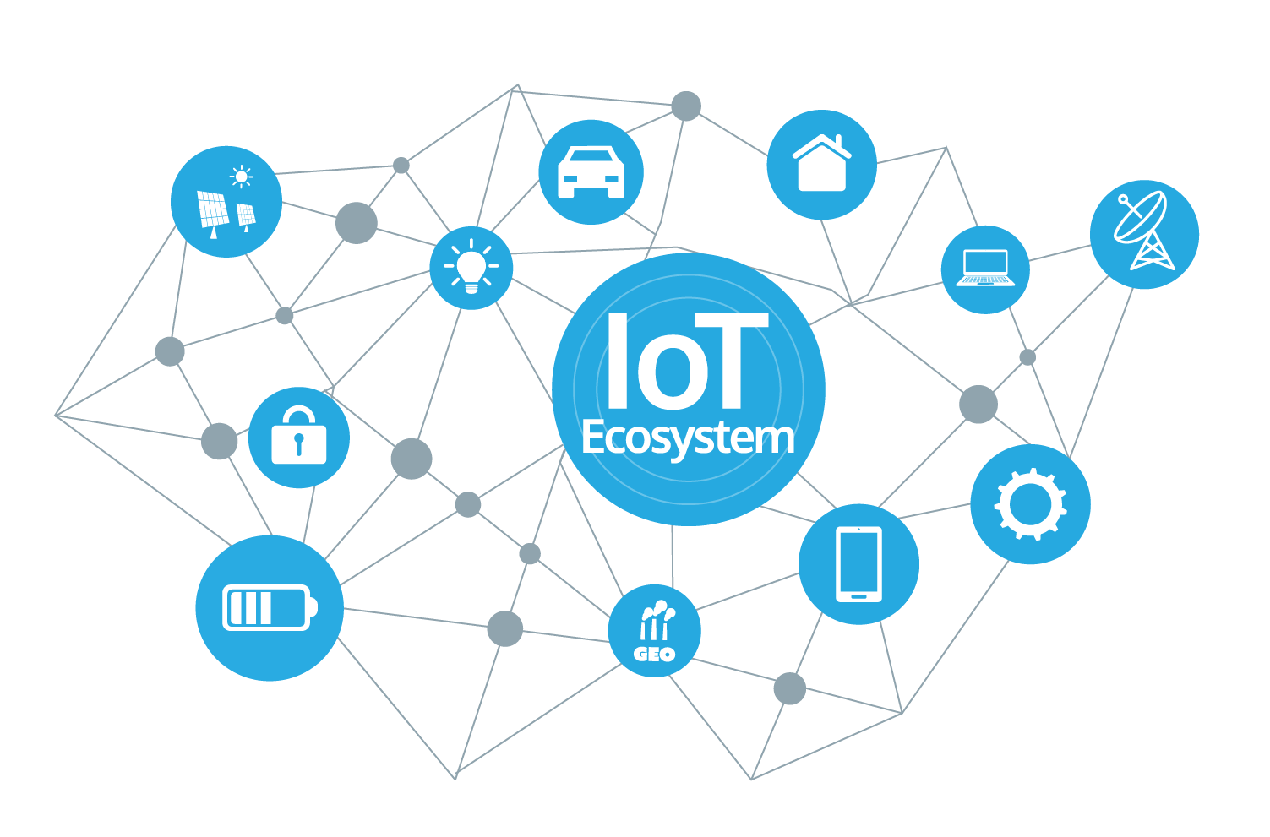
IoT

Slide 2
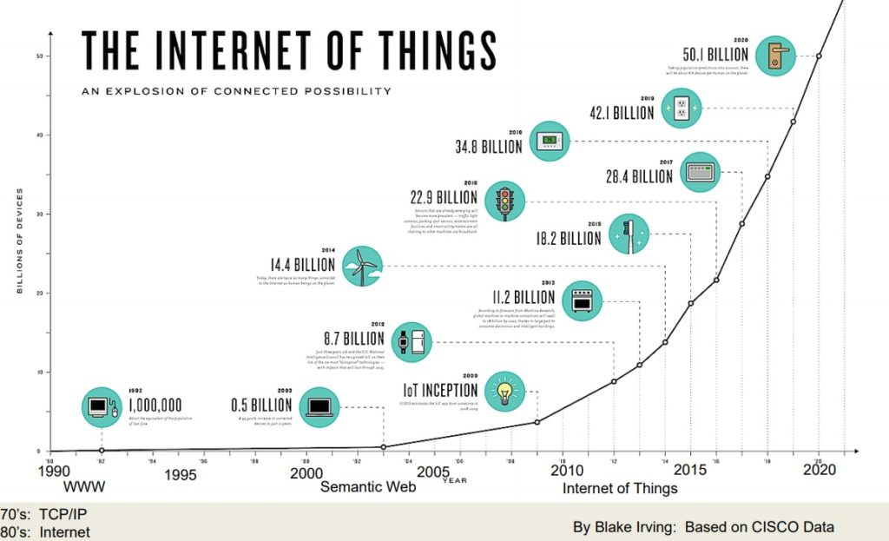
Internet of Things ( )
IoT
It is a system of interrelated computing devices, people, objects or animal that are given a unique identifiers (UIDs). They can transfer data over a network without any interaction from human.

Slide 3

IoT Security
IoT Security is the act of securing the Internet of Things devices and the networks they’re connected to.

Slide 4
1.
IoT Security Issues

Slide 5
IoT Security Issues
Hardcoded or Default Passwords. It can lead to data breaches. Even changed, they often not strong enough to prevent the attacks.
Little or no built-in security which makes them vulnerable to malware.
Usually security is not the top priority of the IoT device makers.

Slide 6
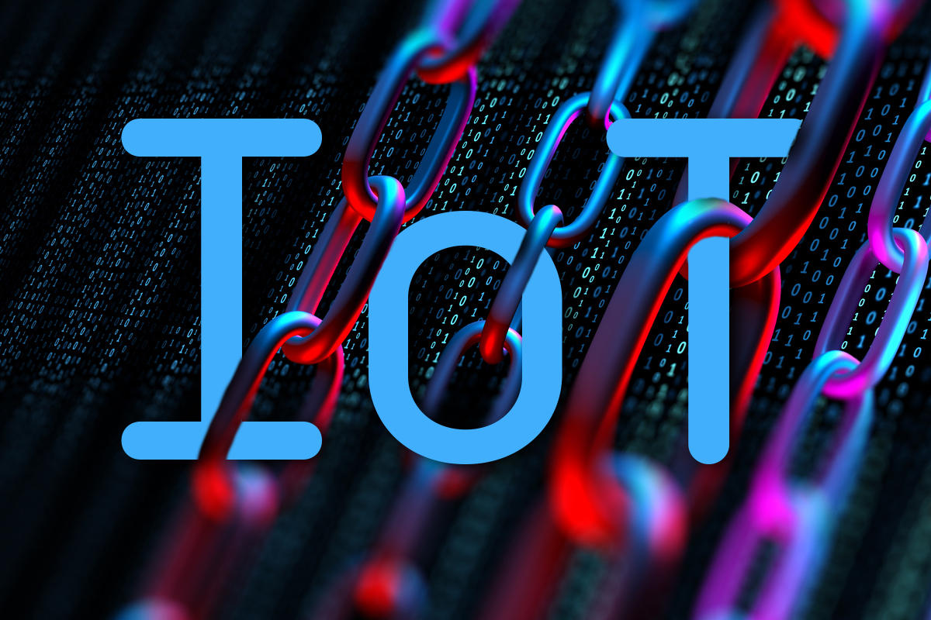
IoT Security Issues
Attacker can hack IoT devices to form a Botnets to perform attacks such as DDoS attack.
Lack of physical security.
Users’ knowledge gap.

Slide 7
2.
IoT security to be considered as alternative for security protection

Slide 8
IoT security to be considered as alternative for security protection
Software protection.
Separating the network.
Create more effective and secure password.
Secure and centralize the access logs of IoT devices.

Slide 9
THANKS YOU!
QnA
Ng Kai Lim
Rowen Lai
Yang Siong Lim
Tan Kok Keong Derek Sathya

